Slide 1
DIGITAfrica: Summer School on Digital Technologies
Configuration and System Management with Ansible

Slide 2
Ansible Intro
Ansible is described as a configuration management tool.
Config management means writing some kind of state description that ensures servers are in the desired state where: the right packages are installed, configuration files have the expected values and have the expected permissions, and the right services are running
Deployment means generating binaries or static assets from source code, copying the required files to servers, configuring properties and environment variables, and starting services in the correct order.
Orchestration, on the other hand, is the process of coordinating deployment when multiple remote servers are involved, and things must happen in a specific order
Looking at this- Ansible can do both configuration management and Deployment and orchestration of services

Slide 3
Why Ansible?
Ansible is an open-source IT automation tool that lets you describe your infrastructure as code — and apply it repeatedly, reliably, and safely.
Agentless- No software needed on target machines — uses SSH to communicate.
Human-Readable- Written in YAML — easy to read, write, and review as a team.
Idempotent -Running a playbook multiple times produces the same result safely.
Modular -Built-in modules handle everything: packages, files, services, cloud.

Slide 4
How Ansible Works
Ansible connects to remote host(s) via SSH and executes configuration, deployment, and orchestration management instructions (tasks) using a script called an Ansible playbook.
The interaction is usually an Ansible Control Host and Managed host(s)
Managed Host 1
Ansible Control Node
Managed Host 2
Managed Host 3 …n

Slide 5
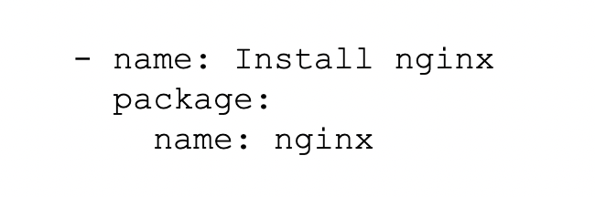
How Ansible Works. Example Task
Ansible will do the following:
1. Generate a Python script that installs the NGINX package
2. Copy the script to host 1, host 2, host 3 …. Host n
3. Execute the script on host 1, host 2, host 3 …. Host n
4. Wait for the script to complete execution on all hosts

Slide 6
Up and Running with Ansible: What you need to do
Ansible is agentless- it does not need an agent on the target host to work
Ansible is written in python so it only expects that the Linux/macOS/BSD systems have Python installed
You need to have SSH access and root privileges on the managed host(s)
You only need to install Ansible on the Ansible Control Host
Install using your Linux/macOS package managers or using the pip Python package manager
Note: Windows is not officially supported to run Ansible, but you can fully manage Windows systems remotely with Ansible, with PowerShell over WinRM under the hood. Or you can go the WSL (Windows Subsystem for Linux) route

Slide 7
Lab 1:Install and Get Started
https://github.com/HumpreyDev/Strathmore-University-Summer-School-on-Digital-Technologies/tree/main → Go to Lab 1 Directory

Slide 8
Ansible Projects
Ansible recommends setting up your project in a modular fashion. This makes it more scalable, easier to manage and allows seamless collaboration. This structure makes the separation of tasks and variables, the reuse of project components such as roles (we will demonstrate this later) also maintains idempotency and readability.
Idempotency is key to Ansible’s Infrastructure as code (IaC) management. This is the ability of an operation to produce the same result regardless of how many times it is repeated

Slide 9
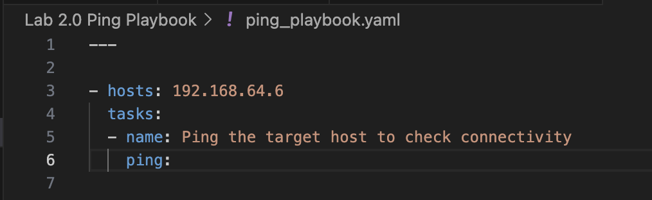
Ansible Playbook
A Playbook is the term that Ansible uses for a configuration management script.
Playbooks are YAML files that inform Ansible about what it should do. Ansible expects to work its way through a list of commands and arguments, as well as any configuration details that may be required
The command: ansible-playbook {name_of_playbook.yaml} runs your playbook
https://github.com/HumpreyDev/Strathmore-University-Summer-School-on-Digital-Technologies/tree/main → . Go to Lab 2.0 Directory to run first ping playbook
.

Slide 10
Basic Syntax rules when working with YAML and Ansible
File Structure: Start every YAML file with --- to indicate the beginning of the document.
Indentation and Spacing: Use two spaces per indentation level. Ensure proper spacing within lists and around colons
Case Sensitivity: YAML is case-sensitive; maintain consistent casing for keys
Save files with .yml or .yaml
Variable Spacing: Always ensure there is a space inside the curly braces when using variables, e.g., {{ variable }}, not {{variable}}.

Slide 11
A more complex playbook
The playbook in https://github.com/HumpreyDev/Strathmore-University-Summer-School-on-Digital-Technologies/tree/main → Go to Lab 2.1:All-In-One-Project Directory
Installs apache web server.
Creates the first web page content
Installs Firewalld and enables port 80
Tests web server locally
What’s wrong with this playbook?

Slide 12
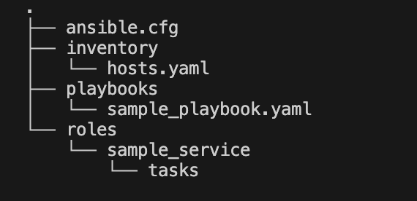
Ansible Projects File Structure
Inventory: This defines the target hosts, at times, a group of hosts. The files are either saved as .ini or .yaml format.
Playbooks- entry point to automation execution files and have the playbook files that will be run
Roles - are reusable units of automation a service or a task. Each role usually has a separate directory for different tasks
ansible.cfg is Ansible's configuration file. It controls how Ansible behaves when running playbooks, and lets you set default settings so you don't have to repeat them on every command or in every playbook.

Slide 13
A more complex playbook v2
The playbook in https://github.com/HumpreyDev/Strathmore-University-Summer-School-on-Digital-Technologies/tree/main → Go to Lab 2.2 Ansible-Directories-Project Directory
We fix the previous all-in-one project into the desired Ansible project file structure. The playbook still does the following:
Installs Apache web server.
Creates the first web page content
Installs Firewalld and enables port 80
Tests web server locally
What’s good with this organisation?

Slide 14
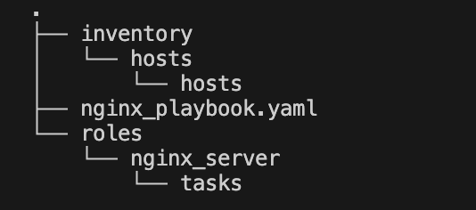
Another way of organizing Ansible Projects File Structure
The playbook in https://github.com/HumpreyDev/Strathmore-University-Summer-School-on-Digital-Technologies/tree/main → Go to Lab 2.3 Ansible-Directories-Project-S2 Directory
What do you notice that is different?
What do you think can be moved to the ansible.cfg file?

Slide 15
Ansible Modules Used in This Playbook: Ref Github: Lab 3.1
A module is a unit of work. Ansible ships with thousands of built-in modules.
apt
apt_key
apt_repository
Manages Debian/Ubuntu packages.
Install, remove, or update with state: latest/present/absent.
Adds a GPG key to the system keyring.
Ensures packages are from a trusted, verified source.
Adds an external software repository.
Tells apt where to find third-party packages like Docker.
pip
command
debug
Installs Python packages via pip.
Used to install the Docker SDK for Python.
Runs a raw shell command.
No shell parsing — safer than shell: for simple commands.
Prints messages or variable values.
Essential for verifying output during a playbook run.

Slide 16
Package Management with the apt Module
Installing a single package:
Key apt Parameters
single_package.yml
Parameter | Purpose
name / pkg | Package name(s) to install
state: latest | Install & upgrade to newest version
state: present | Install only if not already present
state: absent | Remove the package if installed
update_cache: yes | Run 'apt update' before installing
- name: Install aptitude
apt:
name: aptitude
state: latest
update_cache: yes
Installing multiple packages at once:
multi_package.yml
- name: Install system packages
apt:
pkg:
- curl
- ca-certificates
- python3-pip
- virtualenv
state: latest
update_cache: yes
Note: use pkg: with a list to install many packages in a single task — much faster than separate tasks.

Slide 17
Adding External Repositories — The Docker Example
Third-party software (like Docker) lives outside the default Ubuntu repos.
You must add it safely using a 3-step pattern:
Add GPG Key
Add GPG Key
apt_key:
url: https://download.docker.com/linux/ubuntu/gpg
state: present
Verifies that packages really come from the vendor.
Without it, apt will refuse to install from the repo.
Add Repository
Add Repository
apt_repository:
repo: deb https://download.docker.com/
linux/ubuntu jammy stable
state: present
Tells apt where to find Docker packages.
Points to the correct distro codename (jammy = Ubuntu 22.04).
Install Package
Install Package
apt:
name: docker-ce
state: latest
update_cache: yes
Now apt can safely find, verify, and install Docker.
Always run update_cache: yes after adding a new repo.

Slide 18
Capturing Output with register:
register: saves a task's result into a named variable so later tasks can read it.
register_example.yml
- name: Check Docker version
command: docker --version
register: docker_version # <- result stored here
- name: Display the version
debug:
msg: "Docker version: {{ docker_version.stdout }}"
when: docker_version is defined and docker_version.stdout is defined
What's inside a registered variable?
.stdout
Standard output text from the command
.stderr
Error output text (if any)
.rc
Return code: 0 = success, non-zero = failure
.stdout_lines
stdout split into a list, one item per line
.failed
Boolean: true if the task reported failure
.changed
Boolean: true if the task changed something

Slide 19
Jinja2 Templating — Dynamic Values in Playbooks
Ansible uses Jinja2, a Python templating language, to inject dynamic data into tasks, messages, and config files at runtime.
{{ variable_name }} ← replaced with its value at runtime
Where you'll use {{ }}
Print command output
Conditional install
msg: "Docker version: {{ docker_version.stdout }}"
when: ansible_os_family == "Debian"
In a config file (.j2)
Loop over a list
bind-address = {{ db_host }}
port = {{ db_port }}
with_items: "{{ packages_list }}"

Slide 20
Conditional Execution with when:
when: prevents tasks from running unless a condition is true — avoiding errors on missing or undefined data.
when_example.yml
- name: Show hello world output
debug:
msg: "Hello World Output: {{ hello_world_output.stdout }}"
when: hello_world_output is defined # guard 1: variable exists
and hello_world_output.stdout is defined # guard 2: stdout exists
Common when: patterns
variable is defined
Only run if the variable was registered/set
variable.rc == 0
Only run if the previous command succeeded
ansible_os_family == "Debian"
Target only Debian/Ubuntu machines
not variable.failed
Only proceed if the previous task didn't fail
variable.stdout | length > 0
9 / 12
Only run if there was any output

Slide 21
Error Handling — ignore_errors & failed_when
By default, Ansible STOPS a playbook when any task fails.
You control this with ignore_errors and failed_when.
ignore_errors
failed_when
- name: Run optional check
command: some_optional_cmd
register: result
ignore_errors: yes # <- keep going!
- name: Run check
command: check_service.sh
register: result
failed_when:
- result.rc != 0
- '"error" in result.stdout'
ignore_errors: no (default) — stop the playbook on failure. ignore_errors: yes — continue even if this task fails. Use yes sparingly — only for genuinely optional steps where failure is expected and acceptable.
failed_when lets you define exactly what counts as failure — based on return code, output text, or any condition. Use when the tool doesn't return standard exit codes.
10 / 12

Slide 22
Testing & Verification — Never Assume Success
Always verify your installation worked. The playbook uses two checks for Docker:
Test 1 — Check Version
Why this matters:
Confirms the Docker binary is installed and in the system PATH.
If this task fails, the installation itself failed — investigate before proceeding.
Use register: to capture the output, then display it with debug: and {{ docker_version.stdout }}.
- name: Check Docker version
command: docker --version
register: docker_version
ignore_errors: no
Test 2 — Hello World Container
Why this matters:
Full end-to-end test: proves the Docker daemon is running, Docker can pull an image from the internet, and can execute a container successfully.
- name: Run hello-world container
command: docker run hello-world
register: hw_output
ignore_errors: no
11 / 12

Slide 23
More Advanced Playbooks
The playbook in https://github.com/HumpreyDev/Strathmore-University-Summer-School-on-Digital-Technologies/tree/main → Go to Labs
Lab 3.2 MicroK8s Setup Directory
Lab 3.3 Helm Setup Directory

Slide 24
Bonus Task
Write clean-up ansible scripts for all the Labs in the summer-school repository
This cleanup involves removing installed packages and resetting configs
This task will be done in Groups

